Slide 1

Natural Language Processing
Discover how computers understand, interpret, and generate human language to solve real-world problems

Slide 2
Core Components of NLP
Natural Language Processing encompasses two fundamental capabilities that work together to bridge human and machine communication.
Natural Language Understanding (NLU)
Natural Language Generation (NLG)
The ability of machines to comprehend human language, including context, intent, and sentiment. NLU extracts meaning from text and speech.
The process of creating human-readable text from structured data. NLG enables machines to communicate naturally with users.
Semantic analysis
Content creation
Intent recognition
Response generation
Entity extraction
Text summarization

Slide 3





Types of NLP Tasks
Text Classification
Categorizing text into predefined groups like spam detection or sentiment analysis
Named Entity Recognition
Identifying and classifying key entities like names, locations, and organizations
Question Answering
Understanding questions and retrieving relevant answers from text
Machine Translation
Automatically translating text from one language to another

Slide 4

Real-World Applications
Industry Use Cases
Social Impact
Healthcare: Clinical note analysis, patient record summarization, and medical chatbots for preliminary diagnosis
Accessibility: Voice assistants and text-to-speech tools helping people with disabilities
Education: Automated essay grading and personalized learning platforms
Finance: Fraud detection through text analysis, sentiment analysis for market prediction, and automated reporting
Crisis Response: Analyzing social media during disasters to coordinate relief efforts
E-commerce: Product recommendation systems, customer review analysis, and conversational shopping assistants
Mental Health: Chatbots providing 24/7 support and detecting early warning signs
Legal: Contract analysis, document review automation, and legal research assistance

Slide 5





Stages of an NLP Project
Building an NLP system follows a structured pipeline from raw data to deployed solution.
Data Collection
Gather relevant text data from various sources and formats
Preprocessing
Clean and prepare text through tokenization, normalization, and filtering
Feature Engineering
Transform text into numerical representations using embeddings
Model Training
Train machine learning models on processed data
Deployment
Deploy and monitor the model in production

Slide 6

Text Preprocessing: Tokenization
Tokenization is the foundational step in NLP that breaks down text into smaller, manageable units called tokens. This process transforms continuous text into structured data that algorithms can process.
1
2
3
Word Tokenization
Sentence Tokenization
Subword Tokenization
Splits text into individual words based on spaces and punctuation
Divides text into sentences using punctuation markers
Breaks words into smaller meaningful units, handling rare words effectively
"I love NLP!" → ["I", "love", "NLP", "!"]
"Hello world. How are you?" → ["Hello world.", "How are you?"]
"unhappiness" → ["un", "happiness"]

Slide 7

Advanced Tokenization Techniques
Byte-Pair Encoding (BPE)
WordPiece
SentencePiece
Iteratively merges the most frequent character pairs to build a vocabulary
Similar to BPE but selects pairs based on likelihood maximization
Language-independent tokenization treating text as raw sequences
Used in GPT models
Powers BERT models
No pre-tokenization needed
Efficient for rare words
Better for morphology
Handles all languages
Language-agnostic
Handles compounds well
Used in multilingual models
Pro Tip: Modern transformer models often use subword tokenization to balance vocabulary size with representation power, enabling them to handle both common and rare words effectively.

Slide 8



Understanding Embeddings
Word embeddings transform text into numerical vectors that capture semantic meaning, enabling machines to understand relationships between words.
What Are Embeddings?
Dense vector representations where similar words have similar vectors, capturing semantic relationships in continuous space
Why Use Embeddings?
They enable models to understand that "king" and "queen" are related, while "king" and "apple" are distant concepts

Slide 9

The Quest for Meaning: Representing Words in Machines
The Challenge
Why It Matters
How can we represent words numerically so machines can understand and process the complexity of human language?
Enables context understanding across domains
Powers sentiment analysis systems
The Solution
Drives machine translation accuracy
Unlocks semantic search capabilities
Word embeddings map words to dense vectors in continuous space, capturing rich semantic relationships and contextual meaning.
Forms the foundation of modern NLP

Slide 10
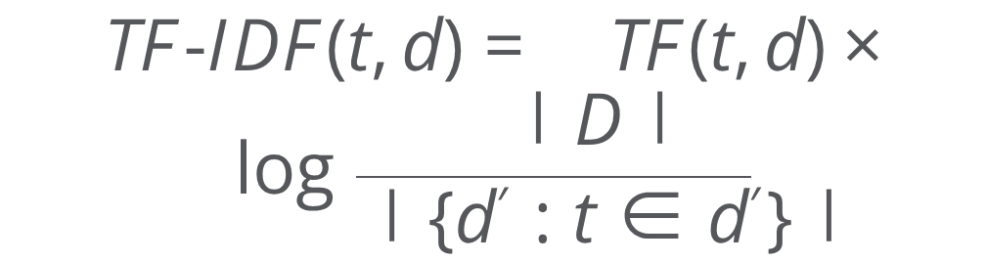
Part 1: Classic Embeddings - The Foundation
One-Hot Encoding
Bag of Words (BoW)
TF-IDF
Concept: Each word maps to a sparse binary vector with a single '1' at its vocabulary index position.
Concept: Represents documents as unordered word frequency collections, discarding grammar and sequence information.
Concept: Weights terms by document frequency while penalizing common corpus-wide words.
Mathematical Form:
Mathematical Form:
Mathematical Form:
Use Case: Simple text classification tasks, categorical input encoding for neural networks.
where c(w_i) is the count of word w_i
Use Case: Document classification, spam detection, topic modeling.
Use Case: Information retrieval, keyword extraction, search engine ranking.
Limitation: Vocabulary-sized dimensionality, no semantic relationships, treats all words as equally distant.
Limitation: Order-agnostic representation loses contextual nuances and sentence structure meaning.
Advantage: Highlights distinctive terms while diminishing stop-word impact, but lacks deep semantics.

Slide 11




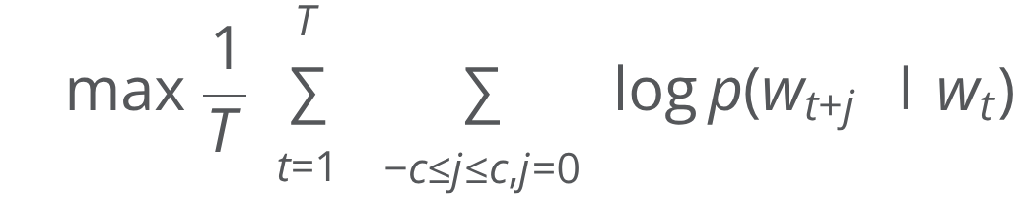
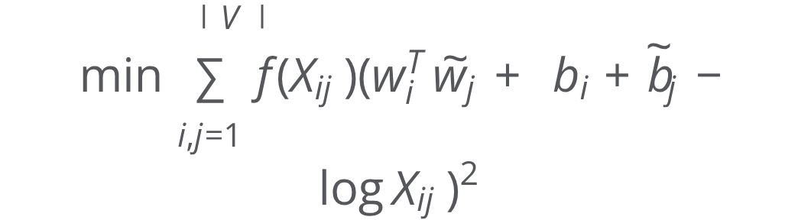
Part 2: Prediction-Based Methods - Learning from Context
These approaches learn distributed representations by predicting linguistic contexts, capturing semantic and syntactic patterns through neural optimization.
Word2Vec
GloVe
FastText
Concept: Learns embeddings by predicting context words from center words (Skip-gram) or vice versa (CBOW).
Concept: Combines global matrix factorization with local context windows using co-occurrence statistics.
Concept: Extends Word2Vec by representing words as sums of character n-gram vectors.
Mathematical Representation:
Mathematical Objective:
Mathematical Objective:
where G_w is the set of n-grams for word w
Use Cases: Semantic similarity computation, word analogy tasks (e.g., "king − man + woman ≈ queen"), feature extraction.
Use Cases: Morphologically rich languages, handling rare/misspelled words, out-of-vocabulary terms.
where X_{ij} represents co-occurrence counts
Use Cases: Capturing word relationships, analogical reasoning, downstream NLP tasks.
Advantage: Subword information enables robust representations for unseen word forms and spelling variations.
Models: Skip-gram excels with rare words; CBOW is faster and better for frequent words.
Advantage: Leverages entire corpus statistics for more comprehensive semantic capture.

Slide 12





Word2Vec: Skip-gram Model in Detail
Input Layer
One-hot encoded target word vector x \in \mathbb{R}^{|V|} representing the center word in vocabulary space.
Hidden Layer (Embeddings)
Word embedding matrix W \in \mathbb{R}^{|V| \times d} acts as lookup table.
This extracts the dense d-dimensional embedding for the target word.
Output Layer
Context matrix W' \in \mathbb{R}^{d \times |V|} computes scores:
Prediction
Softmax converts scores to context word probabilities:
Training Objective: Maximize log-likelihood of observing actual context words, adjusting embeddings through backpropagation to capture semantic relationships in the embedding space.

Slide 13





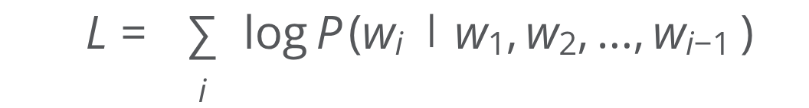
Part 3: Contextual Embeddings - Understanding the Nuances
Unlike static embeddings, contextual models generate dynamic representations where the same word receives different vectors based on surrounding context, capturing polysemy and subtle meaning variations.
BERT
ELMo
GPT
Architecture: Bidirectional Transformer encoder using masked language modeling and next sentence prediction.
Architecture: Deep bidirectional LSTM language model that generates representations from internal states.
Architecture: Unidirectional Transformer decoder trained with causal language modeling on massive text corpora.
Key Innovation: Reads text bidirectionally, understanding full context from both directions simultaneously.
Key Innovation: Produces word representations as weighted combinations of all internal layer outputs.
Key Innovation: Autoregressive generation enabling coherent text production and few-shot learning capabilities.
Mathematical Form:
Mathematical Basis: Self-attention mechanism:
Training Objective:
Use Cases: Improving downstream task performance, handling word sense disambiguation, capturing syntactic and semantic features at different layers.
Use Cases: Text generation, completion tasks, zero-shot learning, conversational AI, and transfer learning for diverse NLP applications.
Use Cases: Question answering, named entity recognition, sentiment analysis, text classification with state-of-the-art accuracy.

